Slide 1
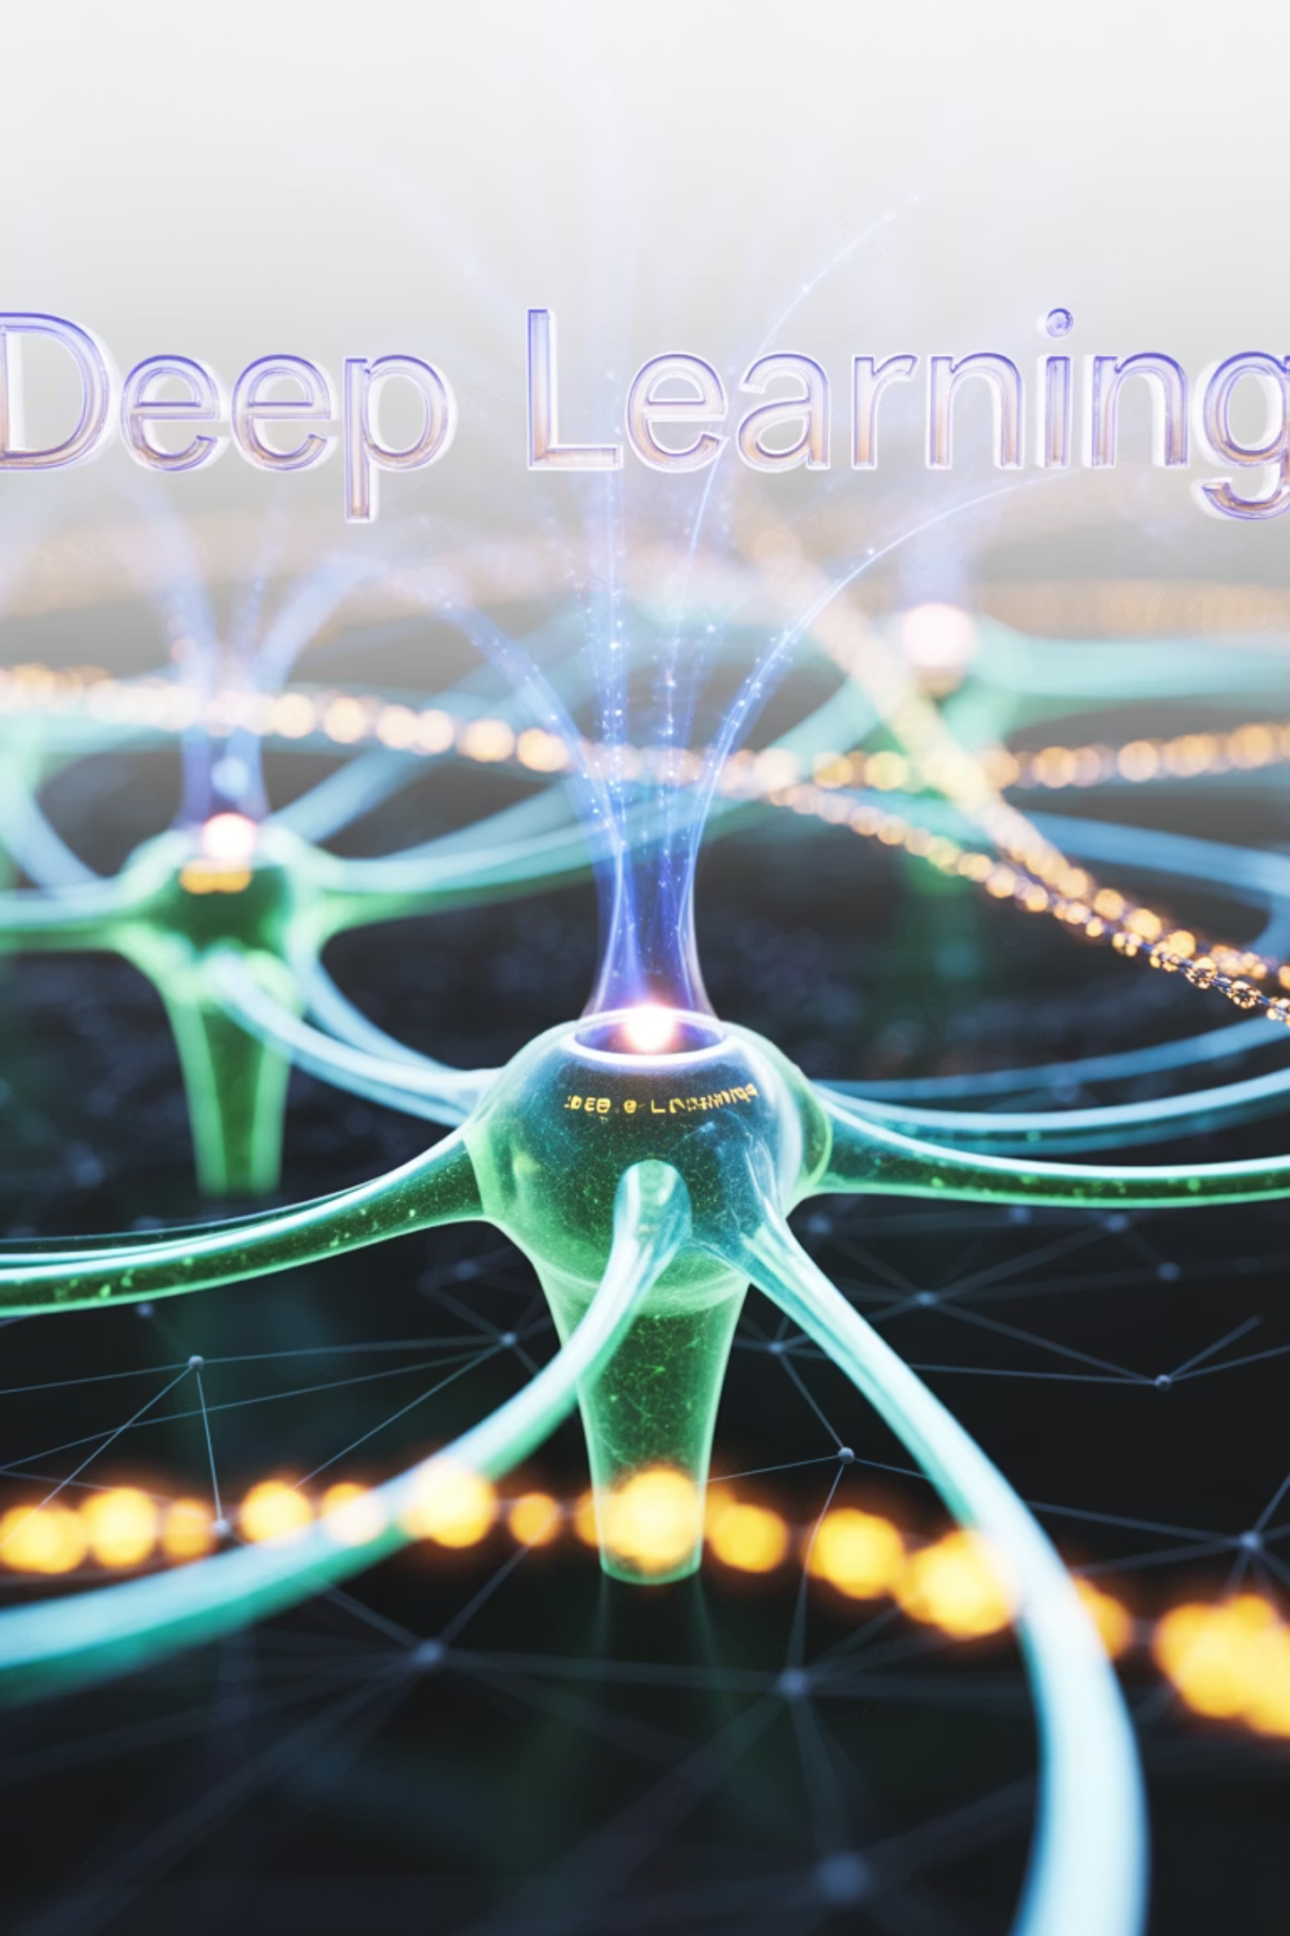
Training Supervised Deep Learning Networks
Welcome to Module 3, where we'll explore how neural networks actually "learn" from data. Think of it like teaching a child to recognize animals - first showing examples, correcting mistakes, and eventually enabling them to identify animals they've never seen before.
In this module, we'll understand CNN training step-by-step, learn about challenges and solutions, explore famous architectures, and see real-world applications you use every day.

Slide 2

What is Supervised Learning?
Learning with a Teacher - Like Learning to Drive
Real-Life Analogy: Learning to Drive a Car
Examples You Use Daily:
Input: What you see (road, signs, other cars)
Output: What you should do (brake, turn, accelerate)
Photo tagging on Instagram
Teacher: Driving instructor who tells you "correct" or "wrong"
In deep learning terms:
Email spam detection
Input: Images, text, audio data
Output: Categories, predictions, classifications
Voice assistants
Teacher: Labeled training data (correct answers)
Goal: Learn to make correct predictions on new, unseen data
Medical image diagnosis
Netflix recommendations
Industry Applications:
Oil & Gas: Analyzing seismic data to find oil deposits
Manufacturing: Quality control on assembly lines
Agriculture: Identifying crop diseases from drone images

Slide 3
The CNN Training Process Overview
From Random Guessing to Expert Recognition
Step 2: Show Examples
Step 1: Random Start
Show thousands of labeled photos: "This is Mom," "This is Dad"
Imagine a person with complete amnesia trying to recognize faces
Person starts noticing patterns: "Mom has curly hair," "Dad wears glasses"
Initially makes completely random guesses - "Is this my mother?" (pointing at a tree)
Step 4: Repeat Until Expert
Step 3: Test and Correct
After seeing thousands of examples and corrections
Show unlabeled photo: "Who is this?"
Can now recognize family members in new photos, different lighting, angles
If wrong: "No, that's your sister, not Mom"
Person adjusts their understanding
In CNN Terms: Random weights → Training data → Error calculation → Weight adjustment → Repeat

Slide 4

Understanding CNN Architecture
The Assembly Line of Vision - How Your Eye Works
Human Vision Analogy: Think about how you recognize your friend in a crowd:
CNN Layers Work Similarly:
Convolutional Layers: Detect edges and textures (like retina)
Layer 1 (Retina)
Pooling Layers: Reduce detail while keeping important features (like focusing)
Detects basic light/dark edges
Fully Connected Layers: Make final decision (like recognition)
"There's a vertical line here, a curve there"
Industry Examples:
Layer 2 (Early Visual Processing)
Oil & Gas: Seismic data analysis - edges become fault lines, shapes become geological formations
Combines edges into shapes
Manufacturing: Surface inspection - edges become scratches, patterns become defects
"These edges form a circle, those form a rectangle"
Medical: X-ray analysis - edges become bone boundaries, shapes become organs
Layer 3 (Object Recognition)
Combines shapes into objects
"Circle + rectangle + lines = a face"
Layer 4 (Face Recognition)
Identifies specific person
"This face pattern matches my friend Sarah"

Slide 5

Convolution Operation - The Feature Detective
The Pattern Detective - Like Finding Waldo
Finding Waldo Analogy:
You have a "Waldo template" in your mind (red striped shirt, hat, glasses)
Industry Applications:
You scan the image systematically, comparing each area to your template
Oil & Gas: Detecting specific wave patterns in seismic data to locate oil reservoirs
When you find a match, you get excited: "Found him!"
Manufacturing: Finding defects by scanning for crack patterns on metal surfaces
Convolution Works the Same Way:
Filter/Kernel = Your "Waldo template" (looking for specific patterns)
Medical: Detecting tumor patterns in MRI scans
Sliding the filter = Scanning the image systematically
Agriculture: Identifying disease patterns on crop leaves from satellite imagery
High response = "I found the pattern!"
Simple Code Concept:
# Conceptual representationfor each_position_in_image: response = compare_with_filter(image_patch, filter) if response > threshold: print("Pattern found at this location!")
Why This Matters: Early layers find simple patterns (edges, textures), while deeper layers combine simple patterns into complex ones (faces, objects, geological formations).

Slide 6
Activation Functions - The Decision Makers
The Brain's On/Off Switch - Like Neurons Firing
The Neuron Firing Analogy: Think of a real brain neuron:
Real-Life Example - Security Guard:
Receives many signals from other neurons
Guard at exclusive club entrance
If total signal is strong enough → FIRE! (send signal forward)
Rule: "If you're on the VIP list (positive), come in as you are"
If too weak → Stay silent
"If you're not (negative), you can't enter at all (zero)"
ReLU (Most Popular) - Like a Light Dimmer:
Sigmoid - Like a Smooth On/Off Switch:
Input below 0: Complete darkness (output = 0)
Old-fashioned activation function
Input above 0: Brightness proportional to input
Smoothly transitions from off (0) to on (1)
Simple rule: "If positive, pass it through; if negative, block it"
Like gradually turning up a light dimmer
Why ReLU Won:
Simple: Easy to compute (just max(0, x))
Fast: No complex math operations
Effective: Solves the "vanishing gradient" problem

Slide 7
Pooling - The Art of Summarization
Zooming Out - Like Looking at a Photo from Far Away
The Photo Album Analogy:
Real-World Example - Sports Highlights:
You have 1000 photos from your vacation
90-minute soccer game → 5-minute highlight reel
Need to create a highlight album with only 100 photos
Keep the most exciting moments (goals, saves, penalties)
Max Pooling = Choose the best photo from each day
Lose boring details (passing in midfield)
Result: Smaller album that captures the essence of your trip
Still captures the essence of the game
How Max Pooling Works:
Why Pooling Matters:
Input: Detailed feature map (like high-resolution photo)
Reduces computation: Fewer pixels to process
Process: Look at small regions (2x2 pixels)
Translation invariance: Object recognition works even if object moves slightly
Output: Keep only the maximum value from each region
Result: Smaller image with most important features preserved
Prevents overfitting: Forces network to focus on important features
Visual Example: Input: [5,7,6,5] → Max Pool → Output: [7]
Input: [2,3,4,1] → Max Pool → Output: [4]

Slide 8

The Training Process - Step by Step
The Learning Loop - Like Practicing Piano
Learning Piano Analogy: Try playing a song (forward pass) → Listen to your mistakes (calculate error) → Figure out which fingers were wrong (backpropagation) → Practice those specific parts (update weights) → Try the song again (next iteration) → Repeat until perfect
1
2
Forward Pass (Making a Prediction)
Calculate Loss (How Wrong Were We?)
Image enters the network
Compare prediction with true answer
Passes through conv layers, pooling, activation functions
If image was actually a dog, we made a big mistake!
Final prediction: "This is 80% likely to be a cat"
Loss = measure of how wrong we were
3
4
Backpropagation (Find the Culprits)
Update Weights (Learn from Mistakes)
"Which weights caused this mistake?"
Adjust weights to reduce future similar errors
Work backwards through network
Tiny adjustments, not dramatic changes
Like detective work: trace the error back to its source
"Next time I see these features, be more careful about predicting 'cat'"
Industry Example - Oil & Gas:
Input: Seismic wave data
Prediction: "80% chance of oil deposit here"
Truth: Drilling confirms or denies oil presence
Learning: Adjust parameters to make better geological predictions
Simple Code Flow:
for each_training_image: prediction = model.forward(image) error = calculate_loss(prediction, true_label) gradients = model.backward(error) model.update_weights(gradients)

Slide 9

Gradient Descent - The Hill Climbing Algorithm
Finding the Valley - Like GPS Navigation in Fog
The Foggy Mountain Analogy:
Learning Rate - Step Size:
You're lost on a mountain in thick fog
Too small: Takes forever to reach bottom (like baby steps)
Goal: Reach the lowest valley (minimum error)
Too large: Might jump over the valley (like giant leaps)
Strategy: Feel the ground slope, take small steps downhill
Just right: Steady progress toward goal
Problem: Can't see the big picture, might get stuck in small dips
Challenges:
Oil & Gas Exploration Parallel:
Local Minima: Getting stuck in small valleys instead of finding the deepest one
Saddle Points: Flat areas where you don't know which way to go
Geologists use similar optimization to find oil deposits
Vanishing Gradients: Steps become so small you stop moving
Goal: Find the optimal drilling location
Method: Analyze seismic data, adjust search parameters
Solutions:
Challenge: Local maxima (small pockets) vs. global maximum (main reservoir)
Momentum: Remember previous directions, build up speed
Adaptive learning rates: Adjust step size automatically
Multiple random starts: Try different starting points
Simple Mathematical Intuition:
# Conceptual gradient descentcurrent_position = random_startwhile not_at_minimum: slope = calculate_gradient(current_position) step_size = learning_rate current_position = current_position - (step_size * slope)

Slide 10
The Vanishing Gradient Problem
The Whisper Game - When Messages Get Lost
The Office Whisper Game:
Real-World Impact:
CEO wants to send a message to the intern (10 levels down)
Why early deep networks (pre-2010) struggled
Each level passes the message but adds their own interpretation
Networks would be 90% accurate on layer 1, but only 60% on layer 10
By the time it reaches the intern: "Increase sales" becomes "Decrease snails"
Historical Solutions:
Problem: Message gets weaker and distorted at each level
Sigmoid problems: Old activation functions made this worse
In Deep Networks:
ReLU Revolution: New activation function that preserves signals better
Better initialization: Starting with better initial weights
Gradient: The learning signal (like the CEO's message)
Many layers: Each layer processes and weakens the signal
Modern Solutions:
Deep layers: Receive very weak learning signals
Residual connections: Skip highways for gradients
Result: Front layers learn well, deep layers barely learn
Batch normalization: Stabilizes learning signals
Better optimizers: Smarter ways to propagate gradients
Analogy: Like installing amplifiers every few floors in the office building to boost the message strength!

Slide 11

Overfitting - The Memorization Problem
Studying vs. Memorizing - When Smart Students Fail Tests
The Exam Preparation Analogy:
In Deep Learning Terms:
Training data: Practice problems
Good Student (Proper Learning)
Test data: Real exam
Studies concepts and patterns
Overfitting: Perfect memorization without understanding
Practices with various problems
Visual Example:
Can solve new problems by applying principles
Test performance: Excellent on unseen questions
Underfitting: Straight line trying to fit curved data (too simple)
Good fit: Smooth curve that captures the pattern
Overfitting: Zigzag line that hits every training point exactly (memorization)
Bad Student (Overfitting)
Detection Signs:
Memorizes only the practice problems
Knows answers by heart but not the concepts
Training accuracy keeps improving
Panics when seeing new question formats
Validation accuracy starts getting worse
Test performance: Perfect on practice, terrible on real exam
Large gap between training and test performance
Real-World Consequences:
Medical AI that works perfectly in lab but fails in hospitals
Self-driving car that crashes on new roads
Recommendation system that only works for training users

Slide 12
Fighting Overfitting - The Solutions Toolkit
Building Robust Learners - Like Teaching Adaptable Students
Strategy 1: More Data (The Exposure Method)
Strategy 2: Data Augmentation (The Simulation Method)
Strategy 3: Dropout (The Team Randomization Method)
Analogy: Teaching a child about dogs by showing them 10,000 different dogs
Analogy: Teaching driving in rain, snow, night, day conditions
Analogy: Basketball team where random players sit out each game
Instead of memorizing specific dogs, they learn what makes a "dog"
Take existing photos and create variations (rotate, flip, change brightness)
Forces all players to be useful, prevents over-reliance on superstars
Real example: ImageNet's success came from having millions of labeled images
One cat photo becomes 20 different cat photos
In CNNs: Randomly "turn off" neurons during training
Real example: Medical imaging where data is scarce
Result: Network can't memorize specific patterns
Strategy 4: Early Stopping (The Smart Quit Method)
Strategy 5: Regularization (The Penalty Method)
Analogy: Stopping dance practice when you peak, before you get tired and sloppy
Analogy: Speed limits on roads penalize going too fast
Monitor validation performance, stop when it starts getting worse
Add penalty for having very large weights
Encourages simpler, more generalizable solutions
Benefit: Prevents the network from starting to memorize

Slide 13

Famous CNN Architectures - The Hall of Fame
The Evolution of Vision - From Pioneers to Superstars
LeNet-5 (1998) - The Pioneer
1
Like the Wright Brothers' first airplane
Simple, small, but proved the concept worked
Use case: Reading zip codes on mail (US Postal Service)
2
AlexNet (2012) - The Game Changer
Architecture: 7 layers, ~60K parameters
Like the iPhone moment changed everything overnight
First to use ReLU and dropout effectively
VGGNet (2014) - The Depth Explorer
3
Achievement: Won ImageNet competition, reduced error by 10%!
Like building the first skyscraper
Innovation: Used GPUs for the first time in deep learning
Proved that deeper networks (19 layers) work better
Innovation: Very small filters (3x3) used everywhere
4
GoogLeNet/Inception (2014) - The Efficiency Expert
Philosophy: "Deeper is better" systematic approach to depth
Like designing a multi-lane highway system
Innovation: Inception modules - multiple operations in parallel
ResNet (2015) - The Highway Builder
5
Achievement: 22 layers but fewer parameters than AlexNet
Like building tunnels through mountains instead of going over
Industry Application: Google Photos search functionality
Problem solved: Very deep networks (152 layers!) without vanishing gradients
Innovation: Skip connections - information highways
Achievement: First to surpass human performance on ImageNet
Oil & Gas Industry Evolution Parallel:
1950s: Manual seismic analysis (LeNet era)
1980s: Computer-assisted interpretation (AlexNet era)
2000s: 3D visualization (VGGNet era)
2010s: Machine learning integration (ResNet era)
2020s: AI-driven exploration (Transformer era)

Slide 14
ResNet Deep Dive - The Skip Connection Revolution
Building Highways in Neural Networks
The Traffic Jam Analogy:
Real-World Benefits:
Old cities: Information must pass through every street (layer)
Problem: Traffic jams at each intersection (vanishing gradients)
1. Gradient Flow
Solution: Build highways that skip congested areas
Like having express elevators in skyscrapers
Result: Information flows freely to destination
Gradients can travel back to early layers quickly
How ResNet Skip Connections Work:
Enables training of very deep networks (100+ layers)
Input → Layer 1 → Layer 2 → Output
↓ ↑
2. Identity Learning
└────────── Skip Highway ──────────┘
If a layer isn't helping, it can learn to "do nothing"
The Math (Simplified):
Output = Input (perfect identity function)
Traditional: Output = Layer2(Layer1(Input))
Network automatically decides which layers are useful
ResNet: Output = Layer2(Layer1(Input)) + Input
Key insight: Adding the input creates a "shortcut"
3. Feature Reuse
Early features (edges, textures) combined with late features (objects)
Like using both foundation and decorative elements in architecture
Impact: Enabled networks deeper than ever before, won ImageNet 2015 with superhuman performance, and became the foundation for most modern architectures.

Slide 15
Training Challenges and Solutions
The Obstacle Course - Common Problems and How to Overcome Them
Challenge 1: Exploding Gradients - The Runaway Train
Challenge 2: Vanishing Gradients - The Dying Signal
Analogy: Train accelerating down a hill without brakes
Analogy: Radio signal getting weaker with distance
Symptoms: Loss jumps to infinity, network becomes unstable
Symptoms: Deep layers stop learning, slow convergence
Solutions:
Solutions:
Gradient clipping (speed limits)
ReLU activation functions
Better weight initialization
Skip connections (ResNet)
Batch normalization
Better optimizers (Adam)
Challenge 3: Dead ReLUs - The Switched Off Neurons
Challenge 4: Internal Covariate Shift
Analogy: Light bulbs that burn out and never turn on again
Analogy: Teaching someone to drive, but the car keeps changing
Cause: Very negative weights that make inputs always negative
Solution: Batch Normalization
Solutions:
Normalizes inputs at each layer
Leaky ReLU (small positive slope for negative inputs)
Like having a consistent, calibrated speedometer
Better learning rates
Proper weight initialization

Slide 16
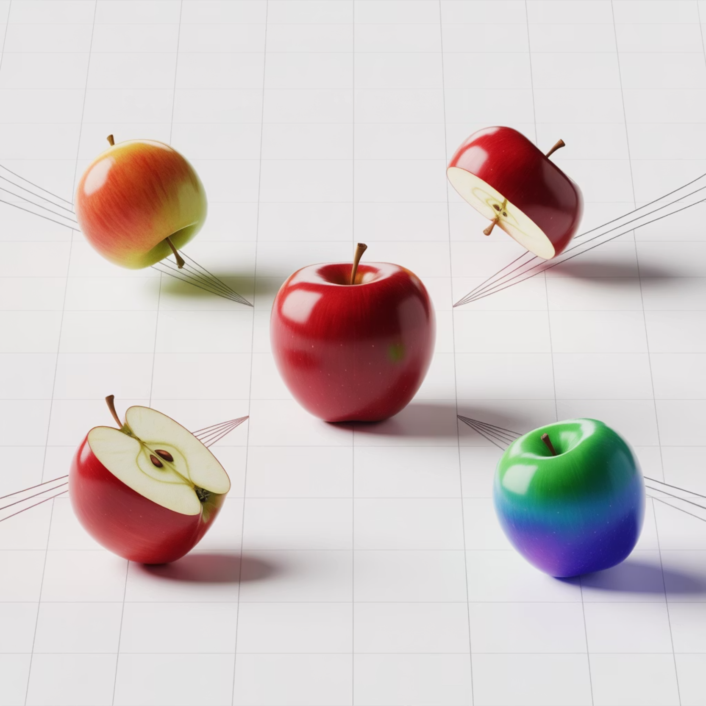
Modern Training Techniques
The Professional Toolkit - Advanced Training Methods
Batch Normalization - The Stabilizer
Transfer Learning - The Knowledge Transfer
Analogy: Like having a thermostat that keeps temperature constant
Concept: Use pre-trained networks as starting point
What it does: Normalizes inputs to each layer
Analogy: Hiring experienced employee vs. training from scratch
Benefits: Faster training, less sensitive to initialization
Process:
Real impact: Reduced training time from weeks to days
Take network trained on ImageNet
Advanced Optimizers - The Smart Navigators
Replace last layer for your specific task
SGD - The Basic Walker
Fine-tune with your data
Takes fixed-size steps toward goal
Benefits: Faster training, less data needed, better results
Simple but effective
Data Augmentation - The Variation Generator
Analogy: Person walking with consistent stride
Create multiple versions of training data
Techniques: Rotation, scaling, color changes, cropping
Momentum - The Cyclist
Result: Network sees more diversity, generalizes better
Builds up speed in consistent directions
Analogy: Bicycle that gains momentum going downhill
Helps escape local minima
Adam - The Smart GPS
Adapts step size based on terrain
Analogy: GPS that adjusts route based on traffic
Most popular for deep learning

Slide 17






Real-World Applications
CNNs in Action - Changing the World Around Us
Medical and Healthcare
Energy and Natural Resources
Skin cancer detection matching dermatologist accuracy
Oil & Gas: Analyzing seismic images to locate deposits
Radiology: Detecting tumors in X-rays, MRIs, CT scans
Pipeline inspection: Detecting corrosion using drone imagery
Drug discovery: Analyzing molecular structures
Solar panel monitoring: Identifying defective panels
Impact: Earlier detection, better treatment outcomes
Geological surveys: Mapping mineral deposits
Autonomous Vehicles
Manufacturing
Object detection: Recognizing cars, pedestrians, signs
Defect detection: Spotting flaws in products
Lane detection: Staying in correct lane
Assembly verification: Ensuring correct component placement
Depth estimation: Understanding 3D space
Surface inspection: Detecting scratches, dents
Weather recognition: Adapting to conditions
Predictive maintenance: Identifying equipment wear
Agriculture
Security and Safety
Crop disease detection from drone/satellite images
Airport security: Detecting prohibited items in X-rays
Yield prediction: Estimating harvest quantities
Facial recognition: Access control systems
Precision agriculture: Optimizing fertilizer and water usage
Video analytics: Monitoring crowds, detecting behavior
Food quality control: Detecting contamination
Fire detection: Early warning systems

Slide 18
Training Best Practices
The Expert's Playbook - How to Train Successfully
Before You Start - Preparation is Key
During Training - Monitoring and Adjustments
1. Data Quality Check
3. Learning Rate Selection
Garbage in, garbage out: Poor data = poor model
Too high: Model jumps around, never converges
Balance: Equal examples of each class
Too low: Training takes forever
Diversity: Represent real-world conditions
Sweet spot: Usually between 0.001 and 0.1
Cleanliness: Remove duplicates, fix labels
Strategy: Start high, reduce when progress stalls
2. Hardware Setup
4. Monitor Key Metrics
GPU is essential: 10-100x faster than CPU
Training vs. Validation Loss: Check for overfitting
Memory considerations: Batch size depends on GPU memory
Accuracy Curves: Should increase over time
Cloud options: AWS, Google Cloud, Azure
Gradient Norms: Check for vanishing/exploding gradients
5. Early Stopping Strategy
Save best model based on validation performance
Stop training when validation stops improving
Prevents wasting time and overfitting
After Training - Evaluation and Deployment
6. Thorough Testing
7. Real-World Validation
Test on completely unseen data
Deploy in controlled environment first
Check performance across different subgroups
Monitor performance in production
Look for bias and fairness issues
Have fallback plans ready

Slide 19

Debugging Neural Networks
When Things Go Wrong - The Troubleshooter's Guide
Problem 1: Loss Not Decreasing
Problem 2: Loss Explodes to Infinity
Symptoms: Loss stays flat or increases
Symptoms: Loss becomes NaN or very large numbers
Possible Causes:
Cause: Exploding gradients
Learning rate too high or too low
Solutions:
Wrong loss function
Reduce learning rate
Data preprocessing issues
Add gradient clipping
Debug Steps:
Check weight initialization
Try different learning rates
Verify data labels are correct
Check if model can overfit small dataset
Problem 3: Training Accuracy High, Validation Low
Problem 4: Both Training and Validation Accuracy Low
Symptoms: Large gap between train/validation performance
Symptoms: Model performs poorly on everything
Cause: Overfitting
Cause: Underfitting
Solutions:
Solutions:
Add dropout or regularization
Increase model complexity
Reduce model complexity
Train for more epochs
Get more training data
Reduce regularization
Improve data augmentation
Check for data quality issues
The Debugging Process:
Start Simple: Use simple model that definitely should work
Overfit Small Dataset: Can your model memorize 100 examples?
Add Complexity Gradually: Increase model size step by step
Monitor Everything: Plot losses, gradients, activations
Compare to Baselines: How does it compare to simple methods?

Slide 20

The Future of CNN Training
What's Next - Emerging Trends and Technologies
Current Trends:
Emerging Technologies:
1. Automated Architecture Search (AutoML)
4. Vision Transformers (ViTs)
Concept: AI designing AI architectures
Innovation: Applying transformer architecture (from NLP) to vision
Analogy: Architect AI that designs buildings automatically
Potential: Might replace CNNs for some applications
Benefits: Finds architectures humans wouldn't think of
Challenge: Need even more data to train effectively
Examples: EfficientNet, found by neural architecture search
5. Self-Supervised Learning
2. Transfer Learning and Pre-trained Models
Goal: Learn without labeled data
Trend: Don't train from scratch, start with proven models
Method: Create artificial tasks from unlabeled data
Impact: Democratizing AI - smaller companies can compete
Impact: Could solve the data labeling bottleneck
Examples: BERT for text, ResNet for images
6. Neural Architecture Search (NAS)
3. Efficient Training
Automation: Let AI find the best architecture
Mixed Precision Training: Use both 16-bit and 32-bit numbers
Efficiency: Focus on mobile and edge devices
Gradient Checkpointing: Trade computation for memory
Sustainability: Reduce energy consumption
Distributed Training: Use many GPUs/computers together
The Bigger Picture:
AI is becoming more accessible
Focus shifting from "can it work?" to "how efficiently?"
Integration with other AI fields (NLP, robotics)
Emphasis on ethical AI and fairness

Slide 21
Your Deep Learning Journey - What We've Learned
The Big Picture
We've covered the complete journey from raw images to intelligent decisions:
Core Concepts Mastered:
1
2
3
CNN Architecture
Training Process
Common Challenges
How layers work together like an assembly line
The learning loop that makes networks smart
Overfitting, vanishing gradients, and how to solve them
4
5
Famous Models
Real Applications
From LeNet to ResNet - the evolution of vision AI
How CNNs are changing industries
Key Insights to Remember
"Deep Learning is Pattern Recognition at Scale"
"Training is Like Teaching a Very Fast Student"
"Modern AI Stands on the Shoulders of Giants"
Networks find patterns humans can't see
Show many examples with correct answers
Build on existing models (transfer learning)
More data + more compute = better performance
Student learns to generalize from examples
Use proven architectures as starting points
But smart design matters more than brute force
Need to prevent memorization (overfitting)
Focus on your specific problem, not reinventing
What's Next for You
Practice
Experiment
Try training your own models
Use pre-trained models for your projects
Stay Updated
Think Ethically
Field moves fast, keep learning
Consider impact and responsibility
Remember: Every expert was once a beginner. The concepts that seem complex today will become second nature with practice!
Final Thought: You now understand the technology behind many AI applications you use daily. Use this knowledge to build something amazing!

